Slide 1
Styling HTML Document with CSS
Pengembangan Berbasis Platform
Semester Gasal 2018/2019

Slide 2
Why CSS?
HTML was NEVER intended to contain tags for formatting a web page!
HTML was created to describe the content of a web page, like:
<h1>This is a heading</h1>
<p>This is a paragraph.</p>
The style definitions are normally saved in external .css files.
With an external stylesheet file, you can change the look of an entire website by changing just one file!

Slide 3
Styling HTML with CSS
CSS stands for Cascading Style Sheets
Styling can be added to HTML elements in 3 ways:
Inline - using a style attribute in HTML elements
Internal - using a <style> element in the HTML <head> section
External - using one or more external CSS files
The most common way to add styling, is to keep the styles in separate CSS files.

Slide 4
Inline Styling (Inline CSS)
Inline styling is useful for applying a unique style to a single HTML element.
Inline styling uses the style attribute.
This inline styling changes the text color of a single heading:
<h1 style="color:blue">This is a Blue Heading</h1>

Slide 5
Internal Styling (Internal CSS)
An internal style sheet can be used to define a common style for all HTML elements on a page.
Internal styling is defined in the <head> section of an HTML page, using a <style> element:

Slide 6
Example - Internal Styling (Internal CSS)
<!DOCTYPE html> <html> <head> <style> body {background-color:lightgrey} h1 {color:blue} p {color:green} </style> </head> <body> <h1>This is a heading</h1> <p>This is a paragraph.</p> </body> </html>

Slide 7
External Styling (External CSS)
External style sheet are ideal when the style is applied to many pages.
With external style sheets, you can change the look of an entire web site by changing one file.
External styles are defined in an external CSS file, and then linked to in the <head> section of an HTML page:

Slide 8
Example: External Styling (External CSS)
<!DOCTYPE html> <html> <head> <link rel="stylesheet" href="styles.css"> </head> <body> <h1>This is a heading</h1> <p>This is a paragraph.</p> </body> </html>

Slide 9
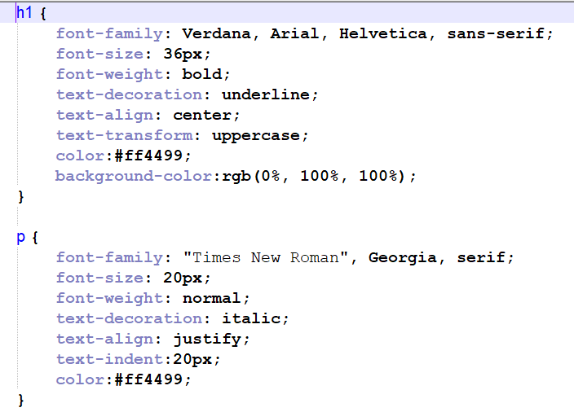
Example: External Styling (External CSS)

Slide 10
Cascading is a method used to resolve potential conflicts between the various types of style sheet a browser supports, and apply them in order of precedence by who created them, the method used to create the style, and the types of properties selected.

Slide 11
Style Sheet Creator
In order of precedence from low to high, they are as follows:
1. Those created by the browser
2. Those created by the user
3. Those created by a document’s author

Slide 12
Style Types
Default Styles
The lowest level of style precedence is the default styling applied by a web browser.
User Styles
These are the next highest precedence of styles, and they are supported by most modern browsers but are implemented differently by each.
External Style Sheets
Internal Styles
Inline Styles

Slide 13
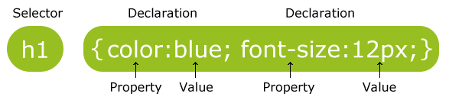
CSS Syntax
The selector points to the HTML element you want to style.
The declaration block contains one or more declarations separated by semicolons.
Each declaration includes a CSS property name and a value, separated by a colon.
A CSS declaration always ends with a semicolon, and declaration blocks are surrounded by curly braces.

Slide 14
CSS Selector
The element Selector
The descendant selector
The child selector
The id Selector
The class Selector
Grouping Selectors

Slide 15
The Element Selector
The element selector selects elements based on the element name.
You can select all <p> elements on a page like this
p { text-align: center; color: red; }

Slide 16
The Descendant Selector
Descendant selectors let you apply styles to elements that are contained within other elements.
For example, the following rule sets all text within <b>...</b> tags to red, but only if they occur within <p>...</p> tags.
Example:
<p><b>Hello</b> there</p>):
p b { color:red; }

Slide 17
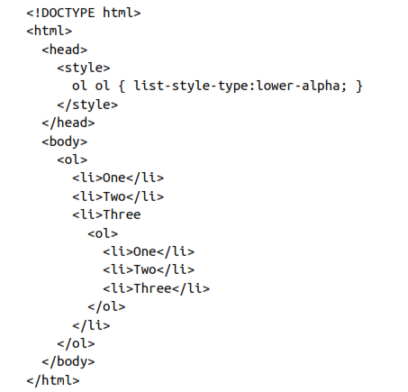
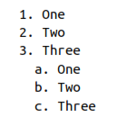
The Descendant Selector (cont.)

Slide 18
The child selector
The child selector is similar to the descendant selector but is more restrictive about when the style will be applied, by selecting only those elements that are direct children of another element.
Html: <p><i><b>Hello</b> there</i></p>
Descendant selector: p b { color:red; }
Child selector: p > b { color:red; }

Slide 19
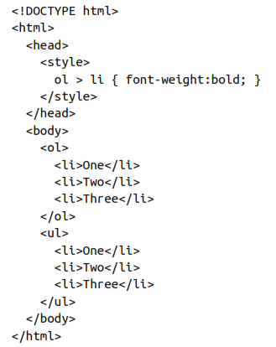


Slide 20

The id Selector
The id selector uses the id attribute of an HTML element to select a specific element.
The id of an element should be unique within a page, so the id selector is used to select one unique element!
To select an element with a specific id, write a hash (#) character, followed by the id of the element.

Slide 21
The class Selector
The class selector selects elements with a specific class attribute.
To select elements with a specific class, write a period (.) character, followed by the name of the class.

Slide 22
Grouping Selectors
h1 { text-align: center; color: red; } h2 { text-align: center; color: red; } p { text-align: center; color: red; }
h1, h2, p { text-align: center; color: red; }

Slide 23
The Attribute Selector
Using this type of selector can save you from having to use IDs and classes to refer to them.
Example:
form input[type="submit"] { width:100px; }
Select only form input elements with that attribute type

Slide 24

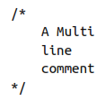
CSS Comments
Comments are used to explain the code, and may help when you edit the source code at a later date.
Comments are ignored by browsers.
A CSS comment starts with /* and ends with */. Comments can also span multiple lines.

Slide 25
Measurement
Units | Descriptions | Examples
Pixel | One pixel equals the width/height of a single dot on the screen, and so this measurement is best suited to monitors. | .classname { margin:5px; }
Points | A point is equivalent in size to 1/72 of an inch. The measurement comes from a print design background. | .classname { font-size:14pt; }
Inches | An inch is the equivalent of 72 points and is also a measurement type best suited for print. | .classname { width:3in; }
Centimeters | One centimeter is a little over 28 points. | .classname { height:2cm; }
Millimeters | A millimeter is 1/10 of a centimeter (or almost 3 points). | .classname { font-size:5mm; }

Slide 26
Measurement (cont.)
Units | Descriptions | Examples
Picas | A pica is another print typographic measurement, which is equivalent to 12 points. | .classname { font-size:1pc; }
Ems | An em is equal to the current font size and is therefore one of the more useful measurements for CSS since it is used to describe relative dimensions. | .classname { font-size:2em; }
Exs | An ex is also related to the current font size; it is equivalent to the height of a lowercase letter x. | .classname { width:20ex; }
Percents | Whereas 1 em equals the current font size, the same size is 100 in percent. When not relating to a font, this unit is relative to the size of the container of the property being accessed. | .classname { height:120%; }

Slide 27
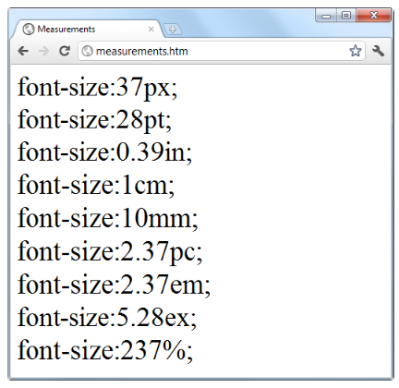
Measurement (cont.)

Slide 28
Fonts and Typhography
Font-family
Font-style
Font-size
Font-weight

Slide 29
Font-family
The font-family property assigns the font to use.
It also supports listing a variety of fonts in order of preference from left to right, so that styling can fall back gracefully when the user doesn’t have the preferred font installed.
Where a font name is made up of two or more words, you must enclose the name in quotation marks.
p { font-family:Verdana, Arial, Helvetica, sans-serif; }
p { font-family:"Times New Roman", Georgia, serif; }

Slide 30
Font-style
With the font-style property, you can choose to display a font normally, in italics, or obliquely.
.normal { font-style:normal; }
.italic { font-style:italic; }
.oblique { font-style:oblique; }

Slide 31
Font-size
There are a two main types you can change a font’s size, they are: fixed and relative.
Fixed
p { font-size:14pt; }
Relative:
h1 { font-size:240%; }
h2 { font-size:200%; }
h3 { font-size:160%; }
h4 { font-size:120%; }

Slide 32
Font-weight
Using the font-weight property, you can choose how boldly to display a font.
Possible values: bold, normal.
.bold { font-weight:bold; }

Slide 33
Managing Text Styles
Decoration
Spacing
Alignment
Tranformation
Indenting

Slide 34
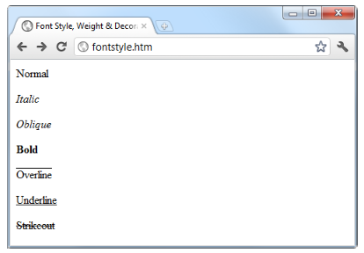
Text-decoration
With the text-decoration property, you can apply effects to text such as underline, line-through, overline, and blink.
.over { text-decoration:overline; }

Slide 35
Spacing
A number of different properties allow you to modify line, word, and letter spacing.
For example, the following rules change the line spacing for paragraphs by modifying the line-height property to be 25 percent greater, the word-spacing property is set to 30 pixels, and letter-spacing is set to 3 pixels.
p {
line-height :125%;
word-spacing :30px;
letter-spacing:3px;
}

Slide 36
Alignment
There are four types of text alignment available in CSS: left, right, center, and justify.
p { text-align:justify; }

Slide 37
Tranformation
There are four properties available for transforming your text: none, capitalize, uppercase, and lowercase.
.upper { text-transform:uppercase; }

Slide 38
Indentation
Using the text-indent property, you can indent the first line of a block of text by a specified amount.
p { text-indent:20px; }

Slide 39
CSS Colors
You can apply colors to the foreground and background of text and objects by using the color and background-color properties.
The colors can be specified in three ways:
named colors: aqua, black, blue, fuchsia, gray, green, lime, maroon, navy, olive, purple, red, silver, teal, white, and yellow.
hexadecimal RGB triplets (such as #ff0000 or #0000ff).
Using the rgb CSS function.

Slide 40
CSS Colors (cont.)
#object { background-color:silver; }
div { color:#ff4499; } OR div { color:#f49; }
body { background-color:rgb(0, 255, 255); }
body { background-color:rgb(0%, 100%, 100%); }

Slide 41
Example: CSS Fonts
<style> h1 { color:blue; font-family:verdana; font-size:300%; } p { color:red; font-family:courier; font-size:160%; } </style>

Slide 42
CSS Positioning
Absolute positioning
An element with absolute positioning is removed from the document, and any other elements that are capable will flow into its released space.
You can then position the object anywhere you like within the document by using the top, right, bottom, and left properties.
#object {
position:absolute;
top :100px;
left :200px;
}

Slide 43
CSS Positioning (cont.)
Relative positioning
Likewise, you can move the object relative to the location it would occupy in the normal document flow.
So, for example, to move object 10 pixels down and 10 pixels to the right of its normal location, you would use the following rules:
#object {
position:relative;
top :10px;
left :10px;
}

Slide 44
CSS Positioning (cont.)
Fixed positioning
The final positioning property setting lets you move an object to an absolute location, but only within the current browser viewport.
Then, when the document is scrolled, the object remains exactly where it has been placed.
#object {
position:fixed;
top :0px;
left :0px;
}

Slide 45
Pseudoclasses & Pseudoelements
Their task is to classify elements using characteristics that cannot be deduced from the document tree.
These include pseudoclasses such as link and visited.
There are also pseudoelements that make a selection, which may consist of partial elements such as first-line or first-letter.
Pseudoclasses and pseudoelements are separated by a : (colon) character.
For example, to create a class called bigfirst for emphasizing the first letter of an element:
.bigfirst:first-letter {
font-size:400%;
float :left;
}

Slide 46
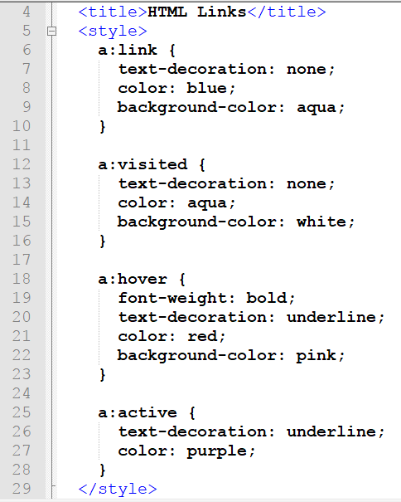
Pseudoclasses & Pseudoelements

Slide 47
Pseudoclasses & Pseudoelements
Another interesting dynamic pseudoclass is focus, which is applied only when an element is given focus by the user selecting it with the keyboard or mouse.
The following rule uses the universal selector to always place a mid-gray, dotted, 2-pixel border around the currently focused object:
*:focus { border:2px dotted #888888; }

Slide 48
CSS Box Model
Every HTML element has a box around it, even if you cannot see it.
Content - The content of the box, where text and images appear
Padding - Clears an area around the content. The padding is transparent
Border - A border that goes around the padding and content
Margin - Clears an area outside the border. The margin is transparent

Slide 49

CSS Box Model (cont.)

Slide 50
CSS Box Model (cont.)
When you set the width and height properties of an element with CSS, you just set the width and height of the content area.
To calculate the full size of an element, you must also add padding, borders and margins.
Total element width = width + left padding + right padding + left border + right border + left margin + right margin
Total element height = height + top padding + bottom padding + top border + bottom border + top margin + bottom margin

Slide 51
CSS Box Model (cont.)
Assume we want to style a <div> element to have a total width of 350px:
div { width: 320px; border: 10px solid green; padding: 20px; margin: 0px; }
320px (width) + 20px (left + right padding) + 10px (left + right border) + 0px (left + right margin) = 350px

Slide 52
CSS Border
CSS border properties allow you to specify the style, width, and color of an element's border.

Slide 53
CSS Border (cont.)
Border-style
p.dotted {border-style: dotted;} p.dashed {border-style: dashed;} p.solid {border-style: solid;} p.double {border-style: double;} p.groove {border-style: groove;} p.ridge {border-style: ridge;} p.inset {border-style: inset;} p.outset {border-style: outset;} p.none {border-style: none;} p.hidden {border-style: hidden;} p.mix {border-style: dotted dashed solid double;}

Slide 54
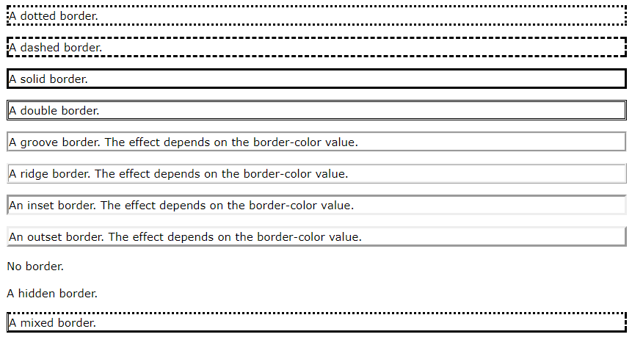
CSS Border (cont.)

Slide 55
CSS Border (cont.)
Border-width
CSS border-width can have from one to four values (for the top border, right border, bottom border, and the left border).
The width can be set as a specific size (in px, pt, cm, em, etc) or by using one of the three pre-defined values: thin, medium, or thick.

Slide 56
CSS Border (cont.)
p.one { border-style: solid; border-width: 5px; } p.two { border-style: solid; border-width: medium; } p.three { border-style: solid; border-width: 2px 10px 4px 20px; }

Slide 57
CSS Border (cont.)
Border-color
The border-color property can have from one to four values (for the top border, right border, bottom border, and the left border).
If border-color is not set, it inherits the color of the element.

Slide 58
p.one { border-style: solid; border-color: red; } p.two { border-style: solid; border-color: green; } p.three { border-style: solid; border-color: red green blue yellow; }

Slide 59
CSS Border (cont.)
Border - Individual Sides
p { border-top-style: dotted; border-right-style: solid; border-bottom-style: dotted; border-left-style: solid; }
p { border-style: dotted solid; }

Slide 60
CSS Border (cont.)
Border - Individual Sides
p { border-style: dotted solid double dashed; }
p { border-style: dotted solid double; }
p { border-style: dotted solid; }
p { border-style: dotted; }
Notes:
If the border-style property has three values:
border-style: dotted solid double;
top border is dotted
right and left borders are solid
bottom border is double
If the border-style property has two values:
border-style: dotted solid;
top and bottom borders are dotted
right and left borders are solid
If the border-style property has one value:
border-style: dotted;
all four borders are dotted

Slide 61
CSS Border (cont.)
Border - Shorthand Property
The border property is a shorthand property for the following individual border properties:
Border-width
Border-style
Border-color
p { border: 5px solid red; }

Slide 62
CSS Border (cont.)
Rounded border
The border-radius property is used to add rounded borders to an element:
p { border: 2px solid red; border-radius: 5px; }

Slide 63
CSS Margin
Individual sides
p { margin-top: 100px; margin-bottom: 100px; margin-right: 150px; margin-left: 80px; }
Shorthand properties
p { margin: 100px 150px 100px 80px; }
p { margin: 100px 150px 100px; }
p { margin: 100px 150px; }
p { margin: 100px; }

Slide 64
CSS Margin (cont.)
Margin Collapse
Top and bottom margins of elements are sometimes collapsed into a single margin that is equal to the largest of the two margins.
This does not happen on left and right margins.
h1 { margin: 0 0 50px 0; } h2 { margin: 20px 0 0 0; }
Common sense would seem to suggest that the vertical margin between the <h1> and the <h2> would be a total of 70px (50px + 20px). But due to margin collapse, the actual margin ends up being 50px.

Slide 65
CSS Padding
Individual sides
p { padding-top: 50px; padding-right: 30px; padding-bottom: 50px; padding-left: 80px; }
Shorthand properties
p { padding: 100px 150px 100px 80px; }
p { padding: 100px 150px 100px; }
p { padding: 100px 150px; }
p { padding: 100px; }

Slide 66
HTML Block Elements

Slide 67
The HTML <div> Element
The HTML <div> element is a block level element that can be used as a container for other HTML elements.
The <div> element has no special meaning. It has no required attributes, but style and class are common.
Because it is a block level element, the browser will display line breaks before and after it.
When used together with CSS, the <div> element can be used to style blocks of content.

Slide 68
Example: <div> element
<div style="background-color:black; color:white; padding:20px;"> <h2>London</h2> <p>London is the capital city of England. It is the most populous city in the United Kingdom, with a metropolitan area of over 13 million inhabitants.</p> </div>

Slide 69
The HTML <span> Element
The HTML <span> element is an inline element that can be used as a container for text.
The <span> element has no special meaning. It has no required attributes, but style and class are common.
Unlike <div>, which is formatted with line breaks, the <span> element does not have any automatic formatting.
When used together with CSS, the <span> element can be used to style parts of the text:

Slide 70
Classing Block Elements
The HTML <div> element is a block level element. It can be used as a container for other HTML elements.
Classing <div> elements, makes it possible to define equal styles for equal <div> elements:

Slide 71
<!DOCTYPE html> <html> <head> <style> .cities { background-color:black; color:white; margin:20px; padding:20px; } </style> </head> <body> <div class="cities">London</div> <div class="cities">Liverpool</div> <div class="cities">Manchaster</div> </body> </html>

Slide 72
Classing Inline Elements
The HTML <span> element is an inline element that can be used as a container for text.
Classing <span> elements makes it possible to design equal styles for equal <span> elements.

Slide 73
Example: Classing Inline Elements
<!DOCTYPE html> <html> <head> <style> span.red {color:red;} </style> </head> <body> <h1>My <span class="red">Important</span> Heading</h1> </body> </html>

Slide 74
Styling Table with CSS
Border (<table> | <th> | <td>)
Border Spacing (<table> | <th> | <td>)
Cell Padding (<th> | <td>)
Text-align (<th> | <td>)
Background-color (<table> | <tr> | <td>)
Different Styles for Different Tables

Slide 75
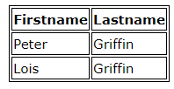
Table – CSS Border
To add borders, use the CSS border property:
table, th, td { border: 1px solid black; }
Remember to define borders for both the table and the table cells.

Slide 76

Table – CSS Border
If you want the borders to collapse into one border, add CSS border-collapse:
table { border-collapse: collapse; } table, th, td { border: 1px solid black; }

Slide 77

table { border: 1px solid black; }

Slide 78
Table Width and Height
table { width: 100%; } th { height: 50px; }

Slide 79
Table - CSS text-align property
To align text in thetable cells use CSS text-align property:
th, td { text-align: left; }

Slide 80
Table - Vertical Alignment
The vertical-alignment property sets the vertical alignment (like top, bottom, or middle) of the content in <th> or <td>.
Deafult value: middle
td { height: 50px; vertical-align: bottom; }

Slide 81
Table with Cell Padding
Cell padding specifies the space between the cell content and its borders.
If you do not specify a padding, the table cells will be displayed without padding.
To set the padding, use the CSS padding property:
th,td { padding: 15px; }

Slide 82

Table - Horizontal Dividers
th, td { border-bottom: 1px solid #ddd; }

Slide 83
Table – CSS backgroud-color
Can be specified to <table> | <tr> | <td>.
table {
background-color: #f1f1c1;
color: white; }

Slide 84
Table - Hover
Use the :hover selector on <tr> to highlight table rows on mouse over:
tr:hover {
background-color: #f5f5f5
}

Slide 85
Strip Table
For zebra-striped tables, use the nth-child() selector and add background-color to all even (or odd) table rows:
tr:nth-child(even) {
background-color: #f2f2f2
}

Slide 86
Different Styles for Different Tables
To define a special style for a special table, add an id attribute to the table:
<table id="t01">
Now you can define style table t01:
table#t01 { width: 100%; background-color: #f1f1c1; }
table#t01 tr:nth-child(even) { background-color: #eee; } table#t01 tr:nth-child(odd) { background-color: #fff; } table#t01 th { color: white; background-color: black; }

Slide 87
Styling List
Different List Item Markers
ul.a { list-style-type: circle; } ul.b { list-style-type: square; } ol.c { list-style-type: upper-roman; } ol.d { list-style-type: lower-alpha; }

Slide 88
Styling List (cont.)
An Image as The List Item Marker
ul { list-style-image: url('sqpurple.gif'); }

Slide 89
Styling List (cont.)
Remove Default Settings
ul { list-style-type: none; margin: 0; padding: 0; }

Slide 90
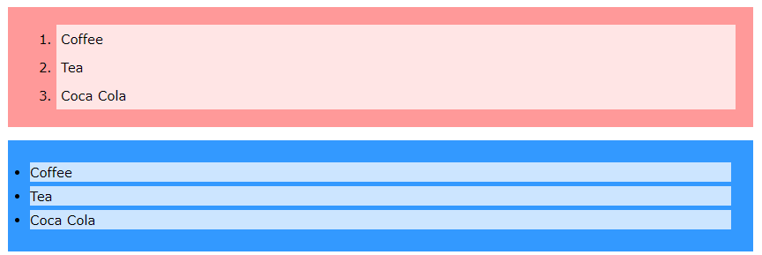
Styling List (cont.)
Coloring list
ol { background: #ff9999; padding: 20px; }
ol li { background: #ffe5e5; padding: 5px; margin-left: 35px; }
ul { background: #3399ff; padding: 20px; } ul li { background: #cce5ff; margin: 5px; }

Slide 91
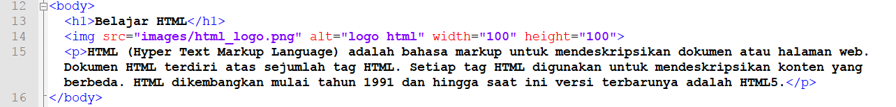
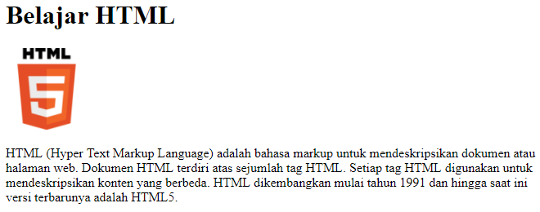
CSS Float

Slide 92
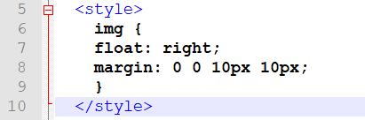
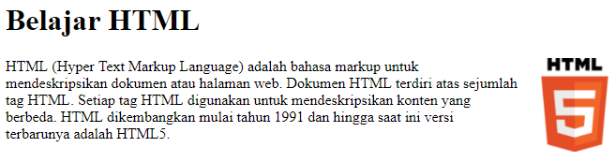
CSS Float (cont.)

Slide 93
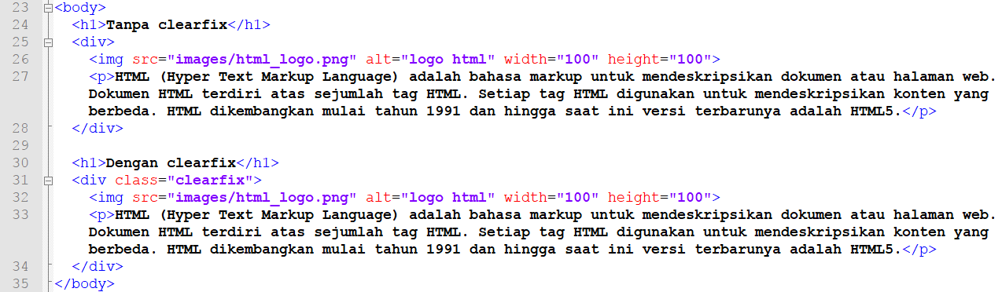
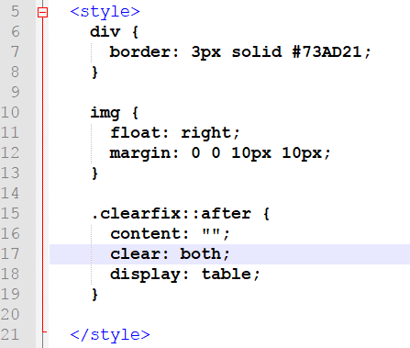
CSS Float (cont.)

Slide 94
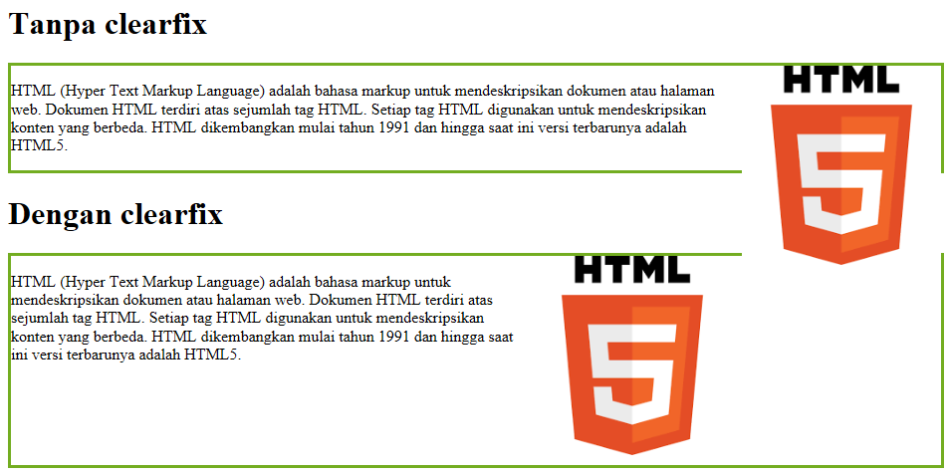
CSS Float (cont.)

Slide 95
KUIS

Slide 96
<div>
<h2>HTML</h2>
<p>Hypertext Markup Language</p>
</div>
<div>
<h2>CSS</h2>
<p>Cascading Style Sheet</p>
</div>
<div>
<h2>XML</h2>
<p>eXtensible Markup Language</p>
</div>
Berikanlah style pada dokumen HTML tsb dengan ketentuan:
Elemen div yang pertama dan ketiga diberi style:
Warna latar belakang: aqua
Warna tulisan: blue
Margin: 10px, padding 10 px
Border dengan style: solid, warna: blue, lebar kanan dan kiri 10px, lebar atas dan bawah 5px.
Elemen div yang kedua diberi style:
Warna latar belakang: grey
Warna tulisan: black
Margin: 15px, padding 15 px
Border dengan style: double, warna: black, lebar kanan dan kiri 5px, lebar atas dan bawah 5px.
Elemen h2 di dalam div diberi style dengan aturan:
Font family: verdana, Arial
Ukuran font: 24px, cetak tebal, bergaris bawah, rata kiri, warna tulisan hitam
Elemen p diberi style dengan aturan
Font-famili : Times New Roman, Georgia, serif
Ukuran huruf: 20px, rata kiri-kanan, tercetak miring

Slide 97
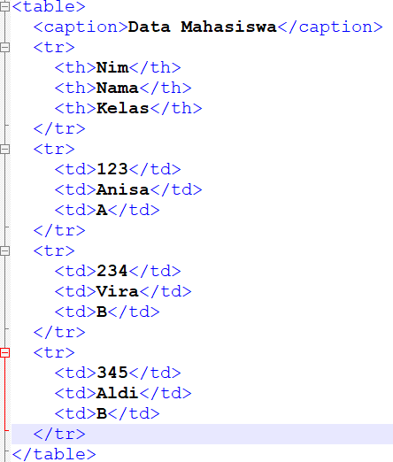
Berikan style dengan aturan:
Lebar tabel 100%
Tidak menggunakan border
Padding kanan-kiri 10 px, atas-bawah 5px.
Semua kolom rata kiri, vertical align untuk judul adalah middle, vertical align untuk isi adalah top.
Ukuran huruf untuk judul 20px, untuk isi 18px.
Baris ganjil berwarna putih, baris genap berwarna #f2f2f2.
Saat mouse diarahkan ke baris tabel, baris tabel menjadi berwarna #f5f5f5.

Slide 98
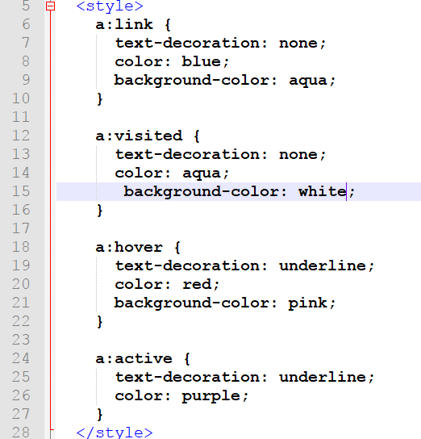
Jelaskan isi dari kode CSS berikut:

